Slide 1
CONTACT MANAGEMENT SYSTEM
PRESENTED BY: Koros Gloria Cherono
REGISTRATION: 1064367
EMAIL: 1064367@cuea.edu
Course Project Presentation
[19/11/2025]

Slide 2
WHAT IS THE CONTACT MANAGEMENT SYSTEM?
A Java-based console application that allows users to:
Store and manage contact information
Perform CRUD operations (Create, Read, Update, Delete)
Search and filter contacts
Persist data to file storage
Key Features
✅ Add new contacts
✅ Update existing contacts
✅ Delete contacts
✅ Search by name
✅ List all contacts
✅ Save/load from file

Slide 3
KEY FEATURES IMPLEMENTED
✓ Complete CRUD Operations
✓ Search & Filter Capabilities
✓ Data Persistence
✓ Input Validation
✓ Error Handling

Slide 4
PROBLEM STATEMENT & SOLUTION
CHALLENGES IN CONTACT MANAGEMENT
• Disorganized contact storage across multiple platforms
• Difficulty in quickly finding specific contacts
• No centralized system for contact management
• Lack of efficient search and update mechanisms
OUR SOLUTIONS
• Unified contact management platform
• Fast search and retrieval capabilities
• Persistent data storage
• User-friendly console interface
• Extensible architecture for future enhancements

Slide 5
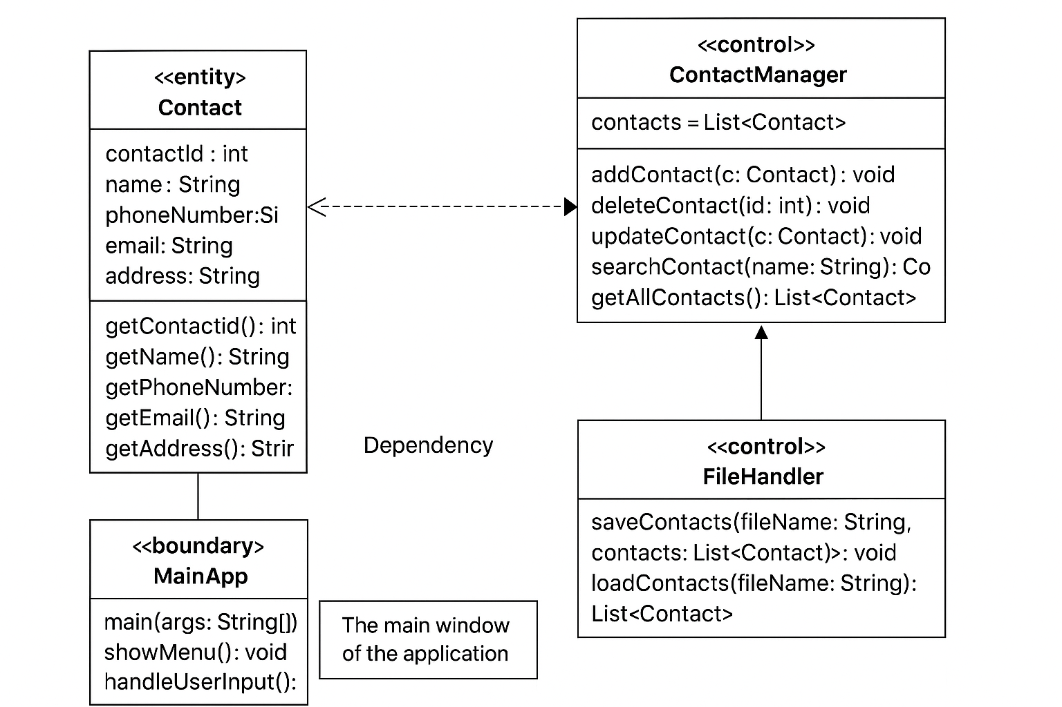
UML COMPONENTS
ENTITY LAYER
• Contact Class: Core data model with attributes
CONTROL LAYER
• ContactManager: Business logic operations
• FileHandler: Data persistence operations
BOUNDARY LAYER
• MainApp: User interface and application flow
RELATIONSHIPS
• ContactManager aggregates Contact objects
• FileHandler depends on Contact objects
• MainApp depends on both Controller classes

Slide 6
USER INTERFACE
MENU SYSTEM DESIGN
=== Contact Management System ===
1. Add Contact
2. Delete Contact
3. Update Contact
4. Search Contacts
5. List All Contacts
6. Save Contacts
7. Load Contacts
8. Exit
Enter your choice: 1
Enter contact ID: 4
Enter name: Alice Brown
Enter phone number: 555-3456
Enter email: alice@email.com
Enter address: 321 Elm Street
Contact added successfully!
UI FEATURES
• Consistent prompt format
• Input validation
• Clear success/error messages
• User-friendly navigation

Slide 7
DATA FLOW DIAGRAM
DATA FLOW - ADD CONTACT SEQUENCE
ADD CONTACT SEQUENCE
1. User selects "Add Contact" from menu
2. MainApp captures user input (showMenu → handleUserInput)
3. MainApp calls ContactManager.addContact()
4. ContactManager validates and stores Contact object
5. User chooses to save data
6. MainApp calls FileHandler.saveContacts()
7. FileHandler writes data to contacts.txt file
SEARCH OPERATION FLOW
User Input → MainApp → ContactManager.searchContact()
→ Filter Logic → Results → MainApp.displayResults()

Slide 8
PROJECT SUMMARY
• Complete contact management solution
• Well-structured Java application
• Easy to understand and extend
TECHNICAL ACHIEVEMENTS:
✅ Clean architecture
✅ Full CRUD operations
✅ Data persistence
✅ User-friendly interface
✅ Modular design

Slide 9
THANK YOU!
@2025

